Slide 1
COMP7035
Python for Data Analytics and Artificial Intelligence
Keras
Renjie Wan, Wei Xue

Slide 2
What we will learn?
Topic |  |  | Hours
I. | Python Fundamentals |  | 12
 | Program control and logic Data types and structures Function File I/O
II. | Numerical Computing and Data Visualization |  | 9
 | Tools and libraries such as NumPy Matplotlib Seaborn
III. | Exploratory Data Analysis (EDA) with Python |  | 9
 | Tools and libraries such as Pandas Sweetviz
IV. | Artificial Intelligence and Machine Learning with Python |  | 9
 | Tools and libraries such as Keras Scikit-learn

Slide 3
Key Components of Keras Pipeline
Dataset?
Load Data
Define Keras Model
Fit Keras Model
Evaluate Keras Model
Tie It All Together
Make Predictions
Learning Target?
Model Structure?
Loss function?
Optimizer?
Training Loop?

Slide 4
Define Keras Model
Keras Layers
A DNN is built from many different types of layers, which mainly include
Linear layers (Dense)
RNN layers
CNN layers

Slide 5
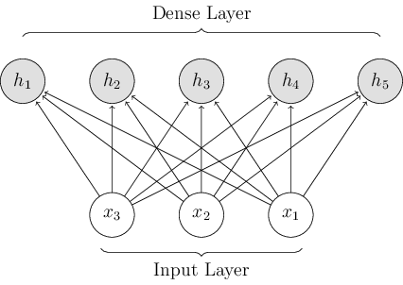
Define Keras Model
Linear layers (Dense)
RNN layers
CNN layers
Keras Layers
Dense( units, activation=None, use_bias=True, kernel_initializer="glorot_uniform", bias_initializer="zeros", kernel_regularizer=None, bias_regularizer=None, activity_regularizer=None, kernel_constraint=None, bias_constraint=None, **kwargs )
You can also specify the input dimension as introduced before

Slide 6

Define Keras Model
Linear layers (Dense)
RNN layers
CNN layers
Keras Layers
LSTM(units, activation="tanh", recurrent_activation="sigmoid", use_bias=True, kernel_initializer="glorot_uniform", recurrent_initializer="orthogonal", bias_initializer="zeros", unit_forget_bias=True, kernel_regularizer=None, recurrent_regularizer=None, bias_regularizer=None, activity_regularizer=None, kernel_constraint=None, recurrent_constraint=None, bias_constraint=None, dropout=0.0, recurrent_dropout=0.0, return_sequences=False, return_state=False, go_backwards=False, stateful=False, time_major=False, unroll=False, **kwargs )
RNN layers takes the sequence as input and output a new sequence.
Mainly used to model sequential data (speech, stock price, etc)
The most used RNN is LSTM (Long Short-Term Memory).

Slide 7

Define Keras Model
Linear layers (Dense)
RNN layers
CNN layers
Keras Layers
Run the codes, check, and understand the dimensions of different tensors.
The first dimension of x is batch size, which will be studied later.
# Define the model using functional API:
from keras.layers import Dense,LSTM
import keras
import numpy as np
x = keras.backend.constant(np.random.randn(1,100,128))
lstm_layer1 = LSTM(512,return_sequences=True)
lstm_layer2 = LSTM(512,return_sequences=False)
y1 = lstm_layer1(x)
y2 = lstm_layer2(x)
for ii in [x,y1,y2]:
print(ii.shape)

Slide 8
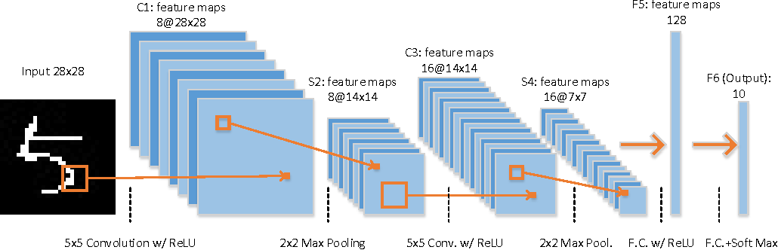
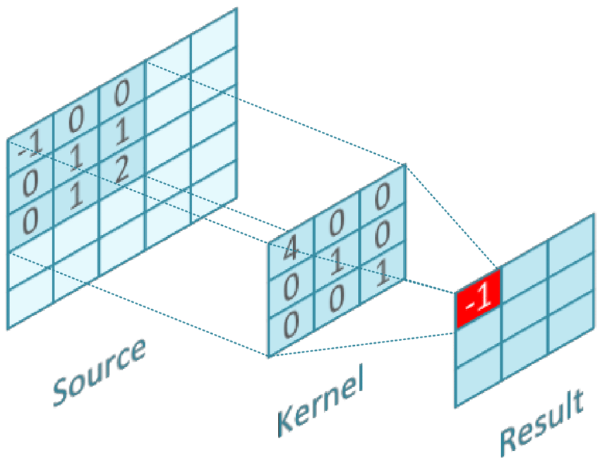
Define Keras Model
Linear layers (Dense)
RNN layers
CNN layers
Keras Layers
2D convolution
Filters (how many do we generate)
filter size (how large do we compute)
Strides (how far do we move)

Slide 9
Define Keras Model
Linear layers (Dense)
RNN layers
CNN layers
Keras Layers
2D convolution
Filters (how many do we generate)
filter size (how large do we compute)
Strides (how far do we move)

Slide 10
Define Keras Model
Linear layers (Dense)
RNN layers
CNN layers
Keras Layers
# Define the model using functional API:
from keras.layers import Dense,Conv2D
import keras
import numpy as np
x = keras.backend.constant(np.random.randn(16,28,28,1))
n_filter = 16
filter_size = 2
cnn_layer1 = Conv2D(n_filter,filter_size,input_shape=(28,28,1))
y1 = cnn_layer1(x)
n_filter = 32
filter_size = 4
cnn_layer2 = Conv2D(n_filter,filter_size,input_shape=(28,28,1))
y2 = cnn_layer2(x)
for ii in [x,y1,y2]:
print(ii.shape)
2D convolution
tf.keras.layers.Conv2D( filters, kernel_size, strides=(1, 1), padding="valid", data_format=None, dilation_rate=(1, 1), groups=1, activation=None, use_bias=True, kernel_initializer="glorot_uniform", bias_initializer="zeros", kernel_regularizer=None, bias_regularizer=None, activity_regularizer=None, kernel_constraint=None, bias_constraint=None, **kwargs

Slide 11
Define Keras Model
Linear layers (Dense)
RNN layers
CNN layers
Keras Layers
# Define the model using functional API:
from keras.layers import Dense,Conv2D
import keras
import numpy as np
x = keras.backend.constant(np.random.randn(16,28,28,1))
n_filter = 16
filter_size = 2
cnn_layer1 = Conv2D(n_filter,filter_size,input_shape=(28,28,1))
y1 = cnn_layer1(x)
n_filter = 32
filter_size = 4
cnn_layer2 = Conv2D(n_filter,filter_size,input_shape=(28,28,1))
y2 = cnn_layer2(x)
for ii in [x,y1,y2]:
print(ii.shape)
2D convolution
tf.keras.layers.Conv2D( filters, kernel_size, strides=(1, 1), padding="valid", data_format=None, dilation_rate=(1, 1), groups=1, activation=None, use_bias=True, kernel_initializer="glorot_uniform", bias_initializer="zeros", kernel_regularizer=None, bias_regularizer=None, activity_regularizer=None, kernel_constraint=None, bias_constraint=None, **kwargs
When using this layer as the first layer in a model, provide the keyword argument input_shape

Slide 12
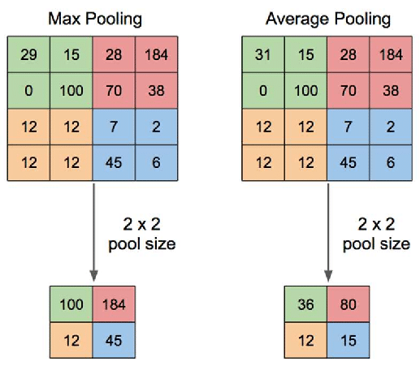

Define Keras Model
Linear layers (Dense)
RNN layers
CNN layers
Keras Layers
MaxPooling2D(pool_size)
Pooling
# Define the model using functional API:
from keras.layers import Dense,Conv2D,MaxPool2D
import keras
import numpy as np
x = keras.backend.constant(np.random.randn(16,28,28,1))
n_filter = 32
filter_size = 4
cnn_layer2 = Conv2D(n_filter,filter_size,input_shape=(28,28,1))
y1 = cnn_layer2(x)
pooling_layer = MaxPool2D(2)
y2 = pooling_layer(y1)
for ii in [x,y1,y2]:
print(ii.shape)

Slide 13
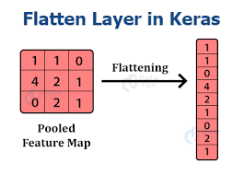

Define Keras Model
Other Common Keras Operations
# Define the model using functional API:
from keras.layers import Flatten,Reshape
from keras.models import Sequential
import keras
import numpy as np
x = keras.backend.constant(np.random.randn(16,28,28,1))
y = Flatten()(x)
n_filter = 32
filter_size = 4
conv_layer = Conv2D(n_filter,filter_size,input_shape=(28,28,1))
z = conv_layer(x)
model = Sequential([conv_layer,Flatten()])
w = model(x)
for i in [x,y,z,w]:
print(i.shape)
Flatten()

Slide 14
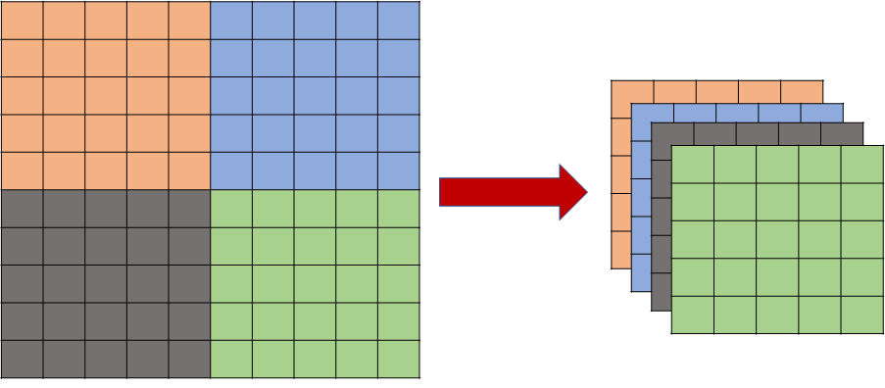

Define Keras Model
Other Common Keras Operations
# Define the model using functional API:
from keras.layers import Flatten,Reshape
from keras.models import Sequential
import keras
import numpy as np
x = keras.backend.constant(np.random.randn(16,28,28,1))
y = Reshape((14,14,-1))(x)
print(y.shape)
y = Reshape((-1,1))(x)
print(y.shape)
Reshape(target_shape)

Slide 15
Exercise
Define the following model using Sequential API. Assuming padding is not used.
Dense Output with Sigmoid
Reshape
conv2D
maxPool2D
conv2D
Flatten
256*256
64*64*16
60*60*32
30*30*32
30*30*1
900
16

Slide 16
Exercise
Define the following model using Sequential API.Assuming padding is not used.
Define the following model using Functional API.
Reshape
conv2D
256*256
64*64*16
concat
60*60*8
conv2D
maxPool2D
60*60*16
240*240*8
60*60*8

Slide 17
Key Components of Keras Pipeline
Dataset?
Load Data
Define Keras Model
Fit Keras Model
Evaluate Keras Model
Tie It All Together
Make Predictions
Learning Target?
Model Structure?
Loss function?
Optimizer?
Training Loop?

Slide 18
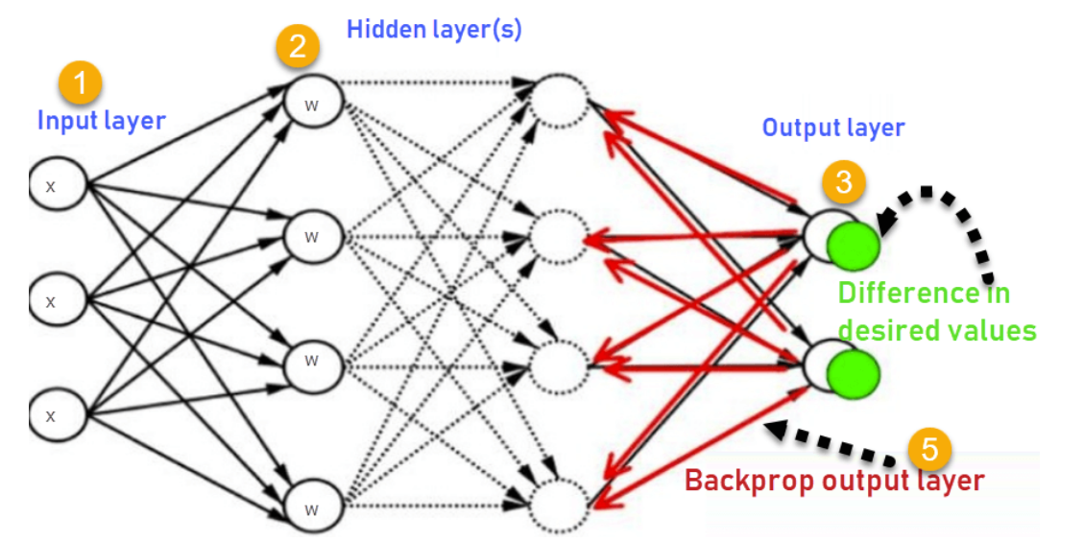
Loss Function
The DNN model is optimized through a feedback backpropogation (BP). The loss function is used to judge how well the model can approximate the desired output.
Types of loss functions
Regression Loss Functions
Classification Loss Functions
Probabilistic Loss Functions
Custom Loss Functions

Slide 19
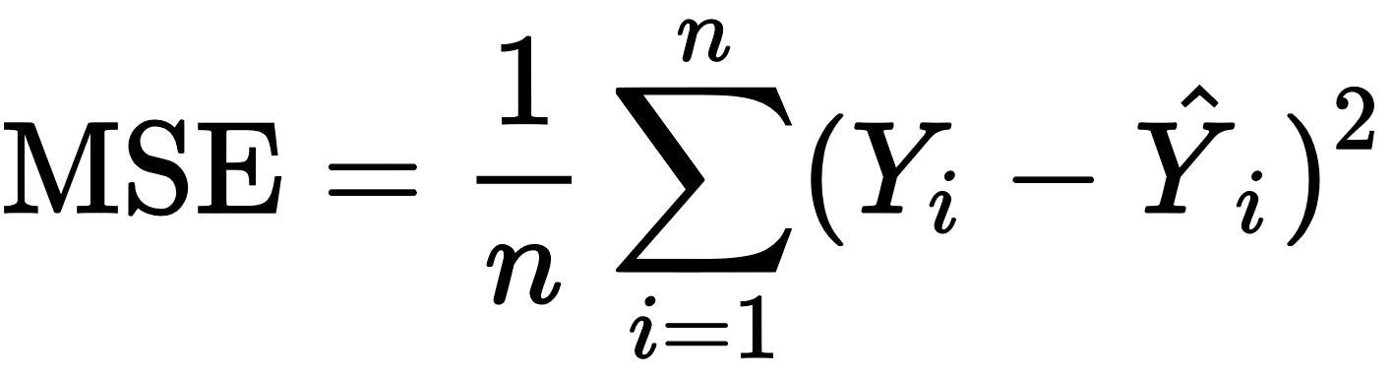
Loss Function
Regression Loss Functions
Mean Squared Error (MSE)
import keras
from keras.losses import MeanAbsoluteError,MeanSquaredError
mse = MeanSquaredError()
y_true = [[0., 0.3], [0., 1.]]
y_pred = [[1., 1.], [1., 0.]]
z = mse(y_true, y_pred)
print(z)
print(z.numpy())

Slide 20
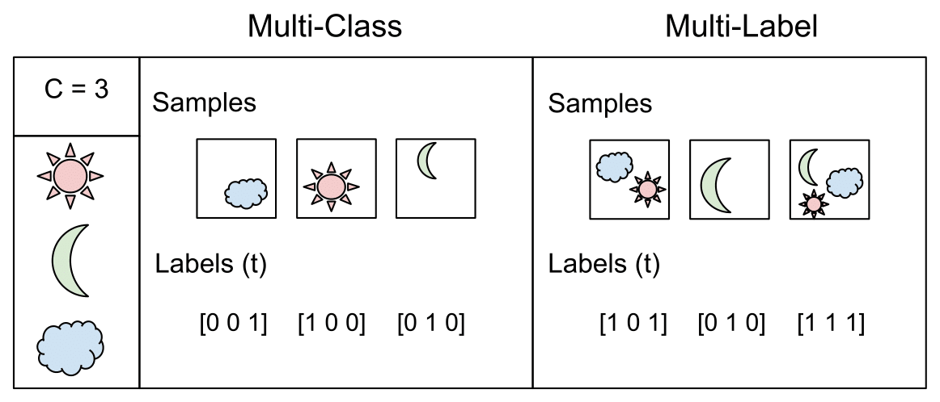
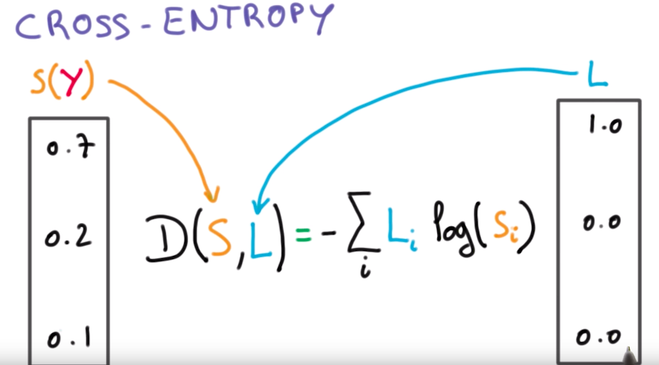
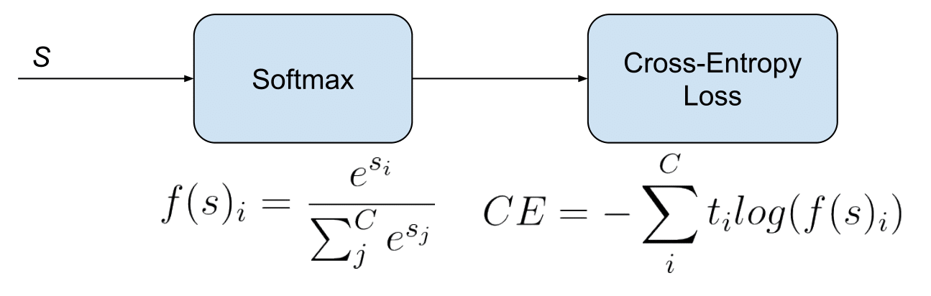
Loss Function
Classification Loss Functions
Categorical Cross-Entropy
import keras
from keras.losses import CategoricalCrossentropy
loss = CategoricalCrossentropy()
y_true = [[0, 1, 0], [0, 0, 1]]
y_pred = [[0.05, 0.95, 0], [0.1, 0.8, 0.1]]
z = loss(y_true, y_pred)
print(z.numpy())
The prediction contains only one class
The label is one-hot

Slide 21
Loss Function
Classification Loss Functions
Categorical Cross-Entropy
import keras
from keras.losses import SparseCategoricalCrossentropy
loss = SparseCategoricalCrossentropy()
y_true = [1，2]
y_pred = [[0.05, 0.95, 0], [0.1, 0.8, 0.1]]
z = loss(y_true, y_pred)
print(z.numpy())
The prediction contains only one class
The label is an integer.

Slide 22
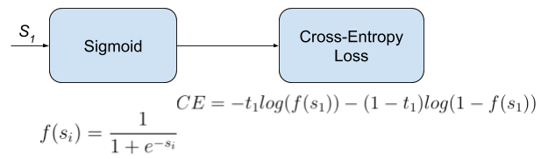
Loss Function
Probabilistic Loss Functions
Binary Cross-Entropy
import keras
from keras.losses import BinaryCrossentropy
loss = BinaryCrossentropy()
y_true = [0, 1, 0, 0]
y_pred = [-18.6, 0.51, 2.94, -12.8]
z = loss(y_true, y_pred)
print(z.numpy())
The prediction can contain multiple classes
The label is multi-hot.

Slide 23
Loss Function
Custom Loss Functions
We can also define the loss as a function of prediction and target.
Supposing we want to define a loss function as MAE+2*MSE
def custom_loss(y_true, y_pred):
# calculate loss, using y_pred
return loss
import keras
from keras.losses import MeanAbsoluteError,MeanSquaredError
def my_loss(y_true, y_pred):
loss = MeanAbsoluteError(y_true, y_pred)+2*MeanSquaredError(y_true, y_pred)
return loss

Slide 24
Loss Function
For the MNIST task, the loss function would be loss = CategoricalCrossentropy()
for one-hot labels;
Or
loss = SparseCategoricalCrossentropy()
for integer-valued labels.

Slide 25
Key Components of Keras Pipeline
Dataset?
Load Data
Define Keras Model
Fit Keras Model
Evaluate Keras Model
Tie It All Together
Make Predictions
Learning Target?
Model Structure?
Loss function?
Optimizer?
Training Loop?

Slide 26
Optimizer
The optimizer specifies how to update the DNN weights according to the loss function values.
SGD
RMSprop
Adam
Adadelta
Adagrad
e.g.,
optimizer = keras.optimizers.Adam()
optimizer = keras.optimizers.Adam(learning_rate=1e-3)

Slide 27
Compile Model
There is one more thing before actually training the model:
How to evaluate the generalization performance, in order to save the best model?

Slide 28
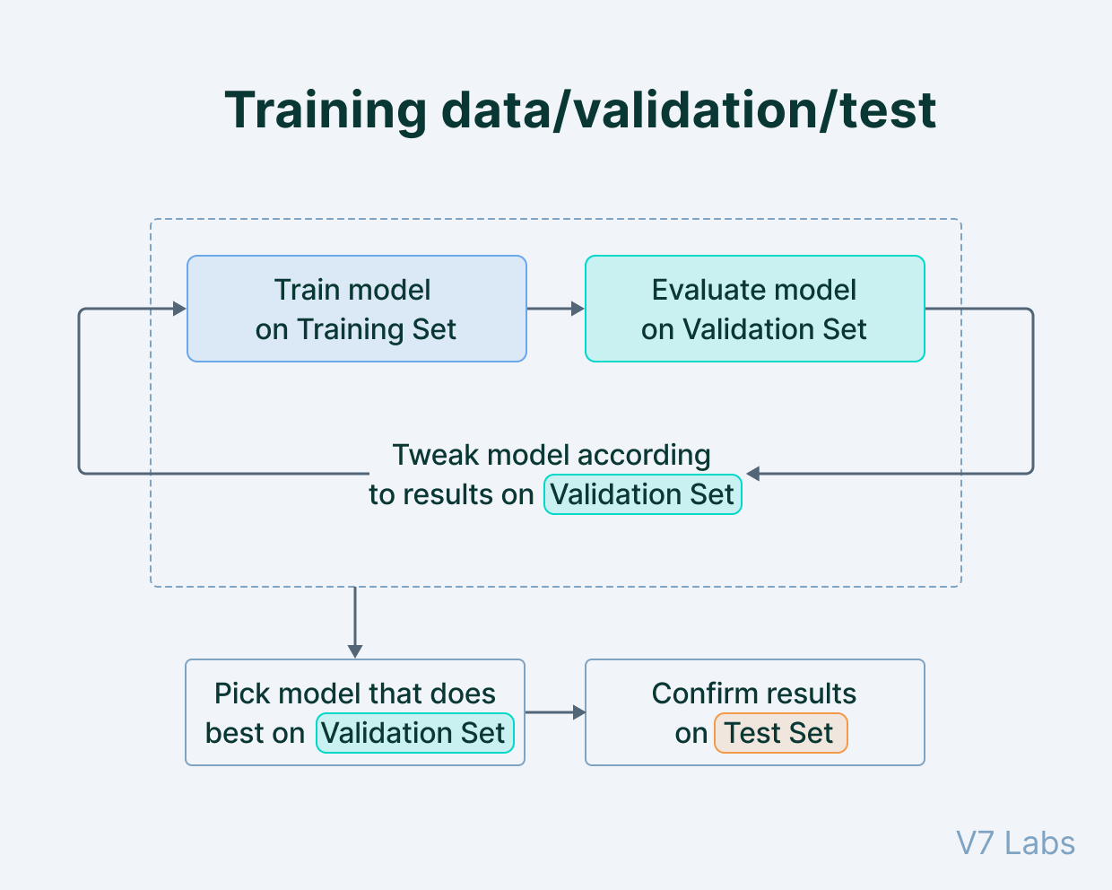
Metrics
During training, we compute the metrics on the validation dataset and choose the model with the best evaluation metric.
Commonly used metric:
Accuracy
MSE
…
The loss function itself can also be taken as the metric.

Slide 29
Compile Model
Accuracy
After we have figured out the loss function and optimizer, we can compile a defined model for training.
model.compile(optimizer=keras.optimizers.Adam(),
loss=keras.losses.SparseCategoricalCrossentropy(),
metrics=[tferas.metrics.Accuracy())
or
model.compile(optimizer=‘adam',
loss= 'sparse_categorical_crossentropy',
metrics=['accuracy'])

Slide 30
Fit Model
Accuracy
The model can be optimized using the built-in API
model.fit
Training set
Training set
Batch 1
Batch size
Batch 1
Batch size
Model.fit(x=None, y=None, batch_size=None, epochs=1, verbose="auto", callbacks=None, validation_split=0.0, validation_data=None, shuffle=True, class_weight=None, sample_weight=None, initial_epoch=0, steps_per_epoch=None, validation_steps=None, validation_batch_size=None, validation_freq=1, max_queue_size=10, workers=1, use_multiprocessing=False, )
Batch 2
Batch 2
Batch 3
Batch 3
…
…
Batch N
val
Batch N
Epoch 1
Epoch 2

Slide 31
Fit Model
Accuracy
The model can be optimized using the built-in API
model.fit
batch_size = 128
epochs = 15
model.fit(x_train, y_train, batch_size=batch_size, epochs=epochs, validation_split=0.1)
Model.fit(x=None, y=None, batch_size=None, epochs=1, verbose="auto", callbacks=None, validation_split=0.0, validation_data=None, shuffle=True, class_weight=None, sample_weight=None, initial_epoch=0, steps_per_epoch=None, validation_steps=None, validation_batch_size=None, validation_freq=1, max_queue_size=10, workers=1, use_multiprocessing=False, )

Slide 32
Exercise
Define the following model using Sequential API. Assuming padding is not used.
Define the following model using Functional API.
Use the structure as below to train a model for the MNIST task. Try using the entire dataset and data generator to train the model.
Input(784) (28*28)
linear(512)+relu
linear(512) +relu
linear(10) +softmax
Output

Slide 33
Key Components of Keras Pipeline
Dataset?
Load Data
Define Keras Model
Fit Keras Model
Evaluate Keras Model
Tie It All Together
Make Predictions
Learning Target?
Model Structure?
Loss function?
Optimizer?
Training Loop?

Slide 34
Evaluate Model
Accuracy
using model.evaluate to evaluate the model, it will give us the loss and the metric values.
Model.evaluate( x=None, y=None, batch_size=None, verbose="auto", sample_weight=None, steps=None, callbacks=None, max_queue_size=10, workers=1, use_multiprocessing=False, return_dict=False, **kwargs )
score = model.evaluate(x_test, y_test)
print('Test loss:', score[0])
print('Test accuracy:', score[1])

Slide 35
Key Components of Keras Pipeline
Dataset?
Load Data
Define Keras Model
Fit Keras Model
Evaluate Keras Model
Tie It All Together
Make Predictions
Learning Target?
Model Structure?
Loss function?
Optimizer?
Training Loop?

Slide 36
Customized Training Loop
Rather than using model.fit, the training loop can also be customized, in order to
Save the model
Adjust the learning rate
etc
Training set
Training set
Batch 1
Batch size
Batch 1
Batch size
Batch 2
Batch 2
Batch 3
Batch 3
…
…
Batch N
val
Batch N
Epoch 1
Epoch 2

Slide 37
Customized Training Loop
The training loop design:
for epoch in range(epochs):
for step, (x_batch_train, y_batch_train) in enumerate(train_dataset):
with tf.GradientTape() as tape:
logits = model(x_batch_train, training=True)
loss_value = loss_fn(y_batch_train, logits)
grads = tape.gradient(loss_value, model.trainable_weights)
optimizer.apply_gradients(zip(grads, model.trainable_weights))
Open a for loop that iterates over epochs
For each epoch, iterate over the dataset in batches
For each batch, open a GradientTape() scope, forward pass and compute the loss
Outside the scope, retrieve the gradients
Use the optimizer to update the model

Slide 38
Customized Training Loop
The training loop design:
val_acc_metric = keras.metrics.SparseCategoricalAccuracy()
best_metric = 10000
for epoch in range(epochs):
for step, (x_batch_train, y_batch_train) in enumerate(train_dataset):
with tf.GradientTape() as tape:
logits = model(x_batch_train, training=True)
loss_value = loss_fn(y_batch_train, logits)
grads = tape.gradient(loss_value, model.trainable_weights)
optimizer.apply_gradients(zip(grads, model.trainable_weights))
for x_batch_val, y_batch_val in val_dataset:
val_logits = model(x_batch_val, training=False)
val_acc_metric.update_state(y_batch_val, val_logits)
val_acc = val_acc_metric.result()
if float(val_acc) < best_metric:
best_metric = float(val_acc)
model.save('path_to_location.h5')
val_acc_metric.reset_states()
Evaluate after each epoch, save the best model

Slide 39
Customized Training Loop
The training loop design:
import keras
from keras import backend as K
val_acc_metric = keras.metrics.SparseCategoricalAccuracy()
best_metric = 10000
for epoch in range(epochs):
for step, (x_batch_train, y_batch_train) in enumerate(train_dataset):
with tf.GradientTape() as tape:
logits = model(x_batch_train, training=True)
loss_value = loss_fn(y_batch_train, logits)
grads = tape.gradient(loss_value, model.trainable_weights)
optimizer.apply_gradients(zip(grads, model.trainable_weights))
K.set_value(model.optimizer.learning_rate, 0.001)
Change the learning rate

Slide 40
Exercise
Define the following model using Sequential API. Assuming padding is not used.
Define the following model using Functional API.
Use the structure as below to train a model for the MNIST task. Try using the entire dataset and data generator to train the model.
Write customized training loop for the MNIST task.
Input(784) (28*28)
linear(512)+relu
linear(512) +relu
linear(10) +softmax
Output

Slide 41
Key Components of Keras Pipeline
Dataset?
Load Data
Define Keras Model
Fit Keras Model
Evaluate Keras Model
Tie It All Together
Make Predictions
Learning Target?
Model Structure?
Loss function?
Optimizer?
Training Loop?

Slide 42
Make Predictions
Model.predict( x, batch_size=None, verbose="auto", steps=None, callbacks=None, max_queue_size=10, workers=1, use_multiprocessing=False, )
prediction = model.predict(x_test)

Slide 43
Exercise
Define the following model using Sequential API. Assuming padding is not used.
# Define the model using functional API:
from keras.models import Sequential
from keras.layers import Dense,Conv2D,MaxPool2D,Input,Reshape,Flatten
import keras
import numpy as np
layers = [Input(shape=(256,256,1)),
Reshape((64,64,-1)),
Conv2D(filters=32,kernel_size=5),
MaxPool2D(2),
Conv2D(filters=1,kernel_size=1),
Flatten(),
Dense(16,activation=‘sigmoid')]
model = Sequential(layers)
model.summary()

Slide 44
Exercise
Define the following model using Sequential API.Assuming padding is not used.
Define the following model using Functional API.
# Define the model using functional API:
from keras.models import Model
from keras.layers import Dense,Conv2D,MaxPool2D,Input,Reshape,Flatten,concatenate
import keras
import numpy as np
def my_model():
# define layers
input_tensor = Input(shape=(256,256,1))
reshape_layer = Reshape((64,64,-1))
conv2d_1 = Conv2D(filters=8,kernel_size=5)
conv2d_2 = Conv2D(filters=8,kernel_size=17)
max_pool_layer = MaxPool2D(4)
input_tensor_reshape = reshape_layer(input_tensor)
conv1_out = conv2d_1(input_tensor_reshape)
conv2_out = conv2d_2(input_tensor)
max_pool_out = max_pool_layer(conv2_out)
cat_out = concatenate([conv1_out,max_pool_out],axis=-1)
model = Model(inputs=input_tensor, outputs=cat_out)
return model
my_model = my_model()
my_model.summary()

Slide 45
Exercise
Use the structure as below to train a model for the MNIST task. Try using the entire dataset and the data generator to train the model.
Input(784) (28*28)
linear(512)+relu
See next page
linear(512) +relu
linear(10) +softmax
Output

Slide 46
Exercise
import pandas as pd
import keras
from keras.models import Sequential
from keras.layers import Dense,Input
from keras.losses import SparseCategoricalCrossentropy
df_orig_train = pd.read_csv('/content/drive/MyDrive/keras/mnist_train.csv',header=None)
df_orig_test = pd.read_csv('/content/drive/MyDrive/keras/mnist_test.csv',header=None)
df_train_values = df_orig_train.values
df_test_values = df_orig_test.values
train_feat_ori,train_label_ori = df_train_values[:,1:]/255.0,df_train_values[:,0]
test_feat,test_label = df_test_values[:,1:]/255.0,df_test_values[:,0]
train_feat,val_feat = train_feat_ori[6000:],train_feat_ori[:6000]
train_label,val_label = train_label_ori[6000:],train_label_ori[:6000]
model = Sequential()
model.add(Input(shape=(784,)))
model.add(Dense(512, activation='relu'))
model.add(Dense(512, activation='relu'))
model.add(Dense(10, activation='softmax'))
model.compile(optimizer='adam',loss= 'sparse_categorical_crossentropy',metrics=['accuracy'])
batch_size = 128
epochs = 8
model.fit(train_feat, train_label, batch_size=batch_size, epochs=epochs, validation_data = (val_feat,val_label))

Slide 47
Exercise
Use the structure as below to train a model for the MNIST task. Try using the entire dataset and the data generator to train the model.
Input(784) (28*28)
linear(512)+relu
See next page
linear(512) +relu
linear(10) +softmax
Output

Slide 48
Exercise
import pandas as pd
import keras
from keras.models import Sequential
from keras.layers import Dense,Input
from keras.losses import SparseCategoricalCrossentropy
import numpy as np
import linecache
import random

Slide 49
Exercise
class DataGenerator(keras.utils.Sequence):
'Generates data for Keras'
def __init__(self, csv_path, indexes, bs):
# initilizes some variables
self.csv_path = csv_path
self.norm_facor = 255.0
self.indexes = indexes
random.shuffle(self.indexes)
self.bs = bs
def __len__(self):
# return the total number of samples in the dataset
return len(self.indexes)//self.bs
def __getitem__(self,index):
# get one sample according to the index
feat_all = []
label_all = []
for this_index in range(index*self.bs,(index+1)*self.bs):
line_index = self.indexes[index]
line_str = linecache.getline(self.csv_path,line_index)
line_val = [int(i) for i in line_str.split(',')]
label = line_val[0]
feat = np.array(line_val[1:])/self.norm_facor
feat_all.append(feat)
label_all.append(label)
return np.array(feat_all),np.array(label_all)

Slide 50
Exercise
indexes = [i for i in range(60000)]
train_index = indexes[6000:]
val_index = indexes[:6000]
batch_size = 128
train_set = DataGenerator('/content/drive/MyDrive/keras/mnist_train.csv',train_index,batch_size)
val_set = DataGenerator('/content/drive/MyDrive/keras/mnist_train.csv',val_index,batch_size)
model = Sequential()
model.add(Input(shape=(784,)))
model.add(Dense(512, activation='relu'))
model.add(Dense(512, activation='relu'))
model.add(Dense(10, activation='softmax'))
model.compile(optimizer='adam',loss= 'sparse_categorical_crossentropy',metrics=['accuracy'])
epochs = 8
model.fit(train_set, steps_per_epoch = len(train_set), epochs=epochs, validation_data = val_set,validation_steps=len(val_set))

Slide 51
Exercise
Define the following model using Sequential API. Assuming padding is not used.
Define the following model using Functional API.
Use the structure as below to train a model for the MNIST task. Try using the entire dataset and data generator to train the model.
Write customized training loop for the MNIST task.
Input(784) (28*28)
linear(512)+relu
linear(512) +relu
linear(10) +softmax
Output

Slide 52
Exercise
import pandas as pd
import keras
from keras.models import Sequential
from keras.layers import Dense,Input
import numpy as np
import linecache
import random
import tensorflow as tf

Slide 53
Exercise
class DataGenerator(keras.utils.Sequence):
'Generates data for Keras'
def __init__(self, csv_path, indexes, bs):
# initilizes some variables
self.csv_path = csv_path
self.norm_facor = 255.0
self.indexes = indexes
self.bs = bs
random.shuffle(self.indexes)
def __len__(self):
# return the total number of samples in the dataset
return (len(self.indexes))//self.bs-1
def __getitem__(self,index):
# get one sample according to the index
feat_all = []
label_all = []
for this_index in range(index*self.bs,(index+1)*self.bs):
line_index = self.indexes[index]
line_str = linecache.getline(self.csv_path,line_index)
line_val = [int(i) for i in line_str.split(',') if len(i)]
label = line_val[0]
feat = np.array(line_val[1:])/self.norm_facor
feat_all.append(feat)
label_all.append(label)
return np.array(feat_all),np.array(label_all)
def shuffle(self):
random.shuffle(self.indexes)

Slide 54
Exercise
indexes = [i for i in range(60000)]
train_index = indexes[6000:]
val_index = indexes[:6000]
batch_size = 128
train_set = DataGenerator('/content/drive/MyDrive/keras/mnist_train.csv',train_index,batch_size)
val_set = DataGenerator('/content/drive/MyDrive/keras/mnist_train.csv',val_index,batch_size)
model = Sequential()
model.add(Input(shape=(784,)))
model.add(Dense(512, activation='relu'))
model.add(Dense(512, activation='relu'))
model.add(Dense(10, activation='softmax'))
model.compile(optimizer='adam',loss= 'sparse_categorical_crossentropy',metrics=['accuracy'])
loss_fn = keras.losses.SparseCategoricalCrossentropy()
optimizer = keras.optimizers.Adam()
val_acc_metric = keras.metrics.SparseCategoricalAccuracy()
epochs = 15
best_metric = 100

Slide 55
Exercise
for epoch in range(epochs):
train_set.shuffle()
for step, (x_batch_train, y_batch_train) in enumerate(train_set):
with tf.GradientTape() as tape:
logits = model(x_batch_train, training=True)
loss_value = loss_fn(y_batch_train, logits)
grads = tape.gradient(loss_value, model.trainable_weights)
optimizer.apply_gradients(zip(grads, model.trainable_weights))
for x_batch_val, y_batch_val in val_set:
val_logits = model(x_batch_val, training=False)
val_acc_metric.update_state(y_batch_val, val_logits)
val_acc = val_acc_metric.result()
print("[{}/{}],val_acc:{}".format(epoch,epochs,float(val_acc)))
if float(val_acc) < best_metric:
best_metric = float(val_acc)
model.save('path_to_location.h5')
val_acc_metric.reset_states()

